Slide 1
Weekly Presentation: Rotor Bearing System
Week number: 03
Date: 07/10/2025
Supervisor: Prof. Quell
Group members: Divyesh Mistry, Venkata Sreekanth .K , Sreehari Padachery, Jill Sadariya
Presenter : Venkata Sreekanth .K
Rotor Bearing System / Optimus Syria

Slide 2
Agenda
Task of the week
Individual responsibility of components
Hydrodynamic vs Hydrostatic
Suggestion for Hydrodynamic bearing
Manufacturing of Shaft
Rotorlocking System
Approached companies & experts
Venkata Sreekanth .K
Rotor Bearing System / Optimus Syria

Slide 3
Task of the week
Divided individual responsibilities of components among team members.
Contacted couple of bearing manufactures and some experts regarding spherical journal bearing suited for 5MW.
Conducted research about the components like rotor lock ,shaft and type of journal bearing.
Venkata Sreekanth .K

Slide 4
Individual responsibility of components
Group Members | Components
Divyesh Mistry & Venkata Sreekanth.k | Rotor Shaft
Jill Sadariya & Sreehari Padachery | Journal Bearing
Jill Sadariya | Rotor Lock
Sreehari Padachery | Bearing Housing
Venkata Sreekanth.k | Coupling
Divyesh Mistry | Flanges
Venkata Sreekanth .K

Slide 5
Hydrodynamic vs Hydrostatic Journal bearing
Feature | Hydrodynamic Bearing | Hydrostatic Bearing
Startup & Low-Speed Operation | High friction | Virtually zero startup friction
Load Carrying Capacity & Stiffness | Depends on rotational speed | Independent of rotational speed.
Maintenance & System Complexity | Mechanically simpler system with fewer components. | More complex system requiring an external pump, filters, piping, and controls
Damping & Vibration Control | Good damping characteristics from the oil film. | Superior damping characteristics, leading to smoother operation and better absorption of vibrations from wind gusts and rotor imbalance.
Cost-Benefit Analysis | Low CAPEX High OPEX | High CAPEX Low OPEX
Venkata Sreekanth .K

Slide 6

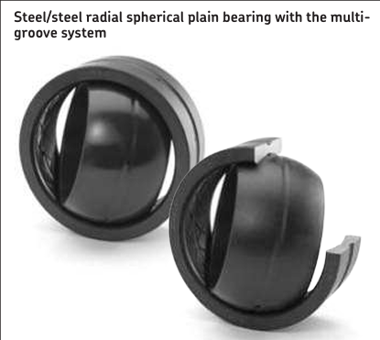
Suggestion for Hydrodynamic bearing
We contacted Howatech Bearings in Germany, and they recommended using a hydrodynamic bearing for the low-speed shaft. For more detailed information, they advised us to get in touch with RENK.
General trend in the wind industry is that Hydrodynamic Journal bearing is used.
Venkata Sreekanth .K

Slide 7
Manufacturing of the Shaft
Forged | Casted
Suitable for cyclic loading, better fatigue behaviour in low-cycle fatigue. | Different cast iron types offer a wide range of property combinations.
Minimizes pores, cavities, and microstructural defects | Volume reduction in low-stress areas can save material, reducing component weight.
Higher strength | can be more brittle
Restricts the shaping of components, limiting design adaptations for specific loading conditions | Suitable for complex shapes and customizations, adaptable to individual loading situations.
Requires higher energy during smelting | Requires less energy for cast iron smelting
Tooling and setup costs can be significant, especially for small production quantities | High damping capacity against vibrations
Material generally used: 42CrMo4 | Material generally used: ductile cast iron EN GJS-400-18-LT and EN GJS-350-22-LT
High Cost of Manufacturing | Low Cost of Manufacturing
Venkata Sreekanth .K

Slide 8
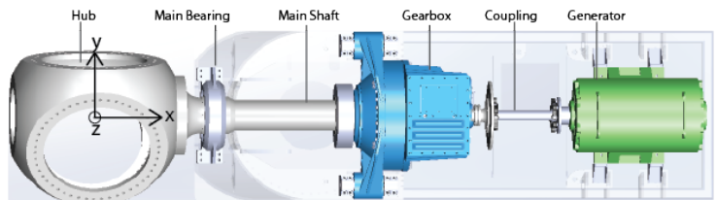
Shaft Dimension
Rotor diameter of the shaft :
Optimus | Rotor diameter | Rotor shaft diameter
Shakti | 178m | 1.4m
60E | 60m | .440m
Syria | 160m | 1.6m
Rotor shaft diameter : +/- 1 or 1.5% of Rotor diameter
By doing some research we assume that the distance between the lever and main bearing should be between 2-3m.
Venkata Sreekanth .K
Rotor Bearing System / Optimus Syria

Slide 9
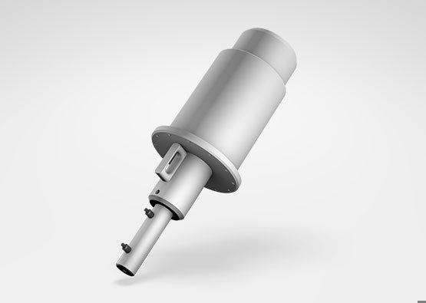
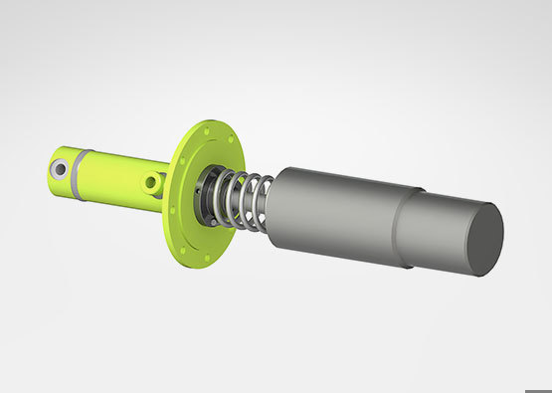
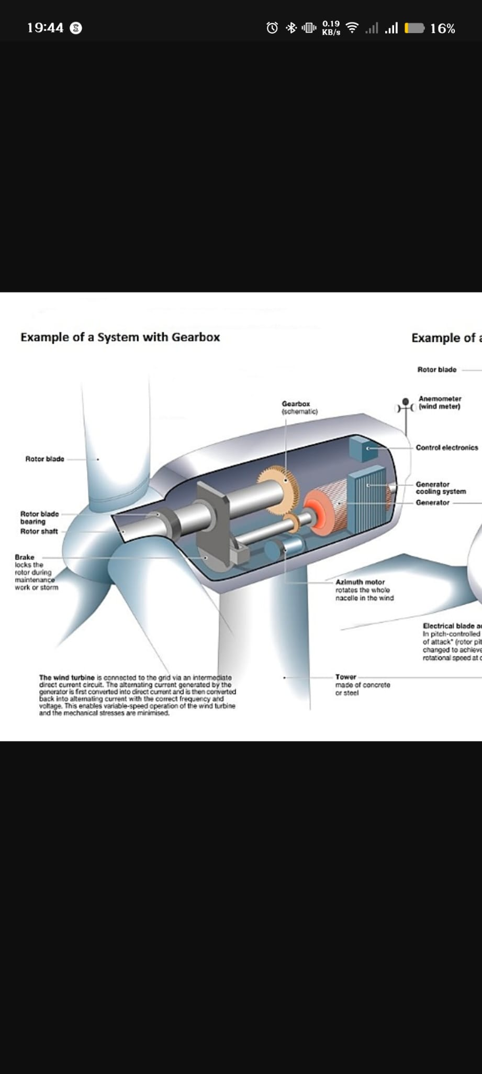
Rotor Locking System
Feature | Hydraulic Caliper Brake with Lock Pin | Purely Mechanical Pin/Ratchet Lock | Gearbox-Integrated Lock
Locking Torque | Very High | Extremely High | High
System Complexity | Moderate to High | Low to Moderate | High
Reliability | Very good | Excellent | Good
Maintenance | Regular inspection required | Simpler maintenance | Difficult
Safety & Redundancy | Excellent | Excellent | Good
Cost | Moderate | Low to Moderate | High
Venkata Sreekanth .K

Slide 10
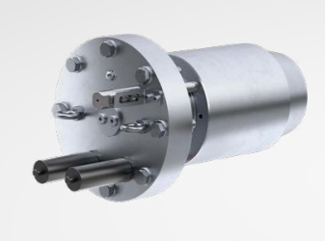
Recommended Rotor Locking System
For a modern 5MW wind turbine, especially in an offshore application, the best and most widely adopted method is the fail-safe Hydraulic Caliper Brake System with an integrated Mechanical Lock Pin.
Reasoning:
Safety through Redundancy: This system provides two crucial functions. The fail-safe brakes can safely stop the rotor in an emergency and hold it, while the mechanical pin offers a secondary, energy-free lock that is essential for ensuring the safety of maintenance crews.
Proven Technology: This approach is mature, well-understood, and has a long track record of reliability in the field.
High Performance: It meets the extreme torque requirements of multi-megawatt turbines and offers powerful dynamic braking, which a purely mechanical lock cannot provide
Venkata Sreekanth .K

Slide 11


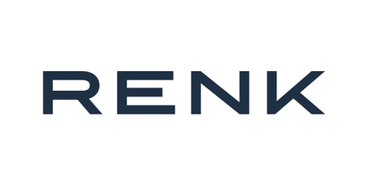
Approached companies & experts
Waiting for reply from the following companies
Bearing specialist from Vestas clearly told they cannot share any information regarding Journal bearing due to competion and confidentiality.
Waiting for reply from Fraunhofer IWES and CSC Bearing Europe GmbH.
Venkata Sreekanth .K

